Slide 1

Minor Project 2021
3D Real-estate Walkthrough
Under the guidance of :
Dr. Jitendra Mohan
(ECE Department)
Presented By:
S.M. Tippu Jani(9918102080)
Vimal Kumar(9918102146)
Yash Jindal(9918102147)

Slide 2

Table of Contents
01
opening
02
Introduction
03
Literature Survey
04
problem statement
05
Implementation
06
Web development
07
3d modelling
08
Snapshots
09
activity flow
10
Advantages
Notes:
© Copyright PresentationGO.com – The free PowerPoint and Google Slides template library

Slide 3

Introduction
Real-Estate is one of the best long term investment options people have.
A lot of people invest money in upcoming or ongoing projects but they often face difficulty in choosing where to invest and where not to.
Our idea is to give the customer more clarity in the property they are looking to invest in by giving them a 3D walkthrough of the same through a realistic 3D model.
This concept allows the clients to experience the property virtually and taking care of the social distancing norms.
Fig 1. Company Logo

Slide 4
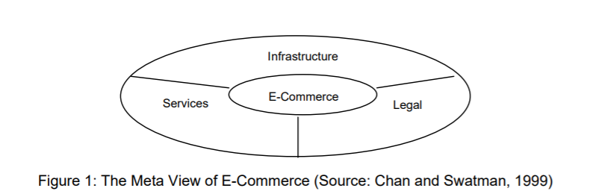
Literature Survey
To assist in the understanding of the workings of electronic commerce and its applicability to SMEs, models of the activity have been examined[1]. The current e-Commerce frameworks and/ or models in the literature seem to come from differing perspectives presenting a range of varying elements.
Chan and Swatman (1999) have developed a dynamic model of e- Commerce, representative of all e-Commerce types, activities and capabilities that demonstrate its performance in product and service terms[2]. The complexity of the framework is modelled into a fluid representation of the varying viewpoints of the stakeholders as displayed in Figure 1.
The boundaries are fluid; subsequently the size of each area is determined by the specific views of the parties involved. Any alteration of the borders does not affect the actual weight of the components within the model. The model also allows for changes over time as objects may be added to or removed from the basic components.[3]

Slide 5

Problem Statement
The global pandemic or the massive outbreak of coronavirus have cost a fortune for almost every business.
The once affected at their peak are the once which require subsequent amount of product evaluation in front.
Real Estate after the restrictions have been forced to come on its knees with people not able to go and see thus leading to dip in purchases .
Fig 2. Problem Statement

Slide 6
Problem Statement(contd.)
A world in which not e-commerce is the future , providing people with physical like experience is an opportunity to seek.
With features like 360 view of houses and three dimensional views of both exterior and interior saves both time as well as providing more options to the customer. A person is more likely to invest if what he sees is what the actual property looks like.
We are not just covering blueprints we are relishing the way the experience is meant to be maximized.

Slide 7
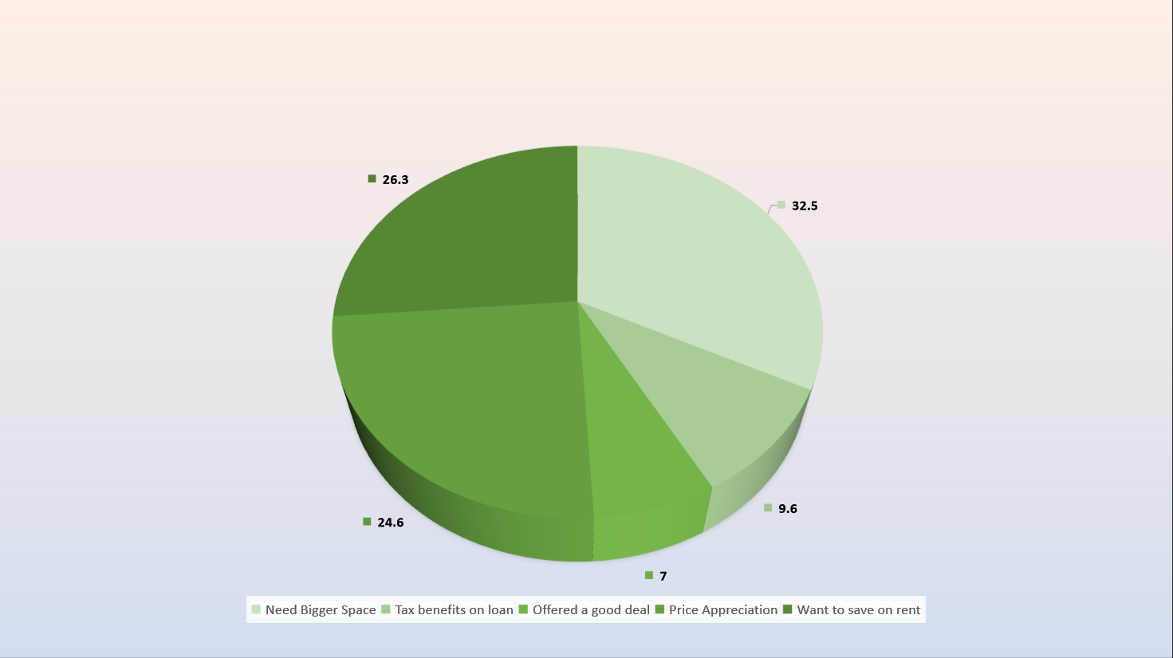
Reasons for buying a House

Slide 8
Implementation of project

Slide 9
Implementation
No.1
3D walkthrough
Implementation
No onsite visit
No.2
No.3
Implementation
Buy/Sell

Slide 10
No.4
Frontend
HTML
Frontend
CSS
No.5
No.6
Frontend/Backend
JS

Slide 11
No.7
Server Scripting
PHP
Features
Instant Callback
No.8
Features
No.9
24*7 Support

Slide 12

Web Development
Web Development is the building and maintenance of websites; it’s the work that happens behind the scenes to make a website look great, work fast and perform well with a seamless user experience.
The languages they use depends on the types of tasks they are performing and the platforms on which they are working.
This picture is not an actual representation of the code.

Slide 13



HTML vs CSS vs JS
HTML is a markup language for describing web documents (web pages).
HTML uses tags to help you add paragraphs, headers, pictures, bullets and other pieces of structure.
CSS describes how HTML elements are to be displayed on screen, paper, or in other media.
Created to compliment HTML, CSS (Cascading Style Sheets) is what makes a website look and feel amazing.
JavaScript (JS) is a scripting languages, primarily used on the Web.
This allowing the pages to react to events, exhibit special effects, accept variable text, validate data, create cookies, detect a user’s browser, etc.

Slide 14

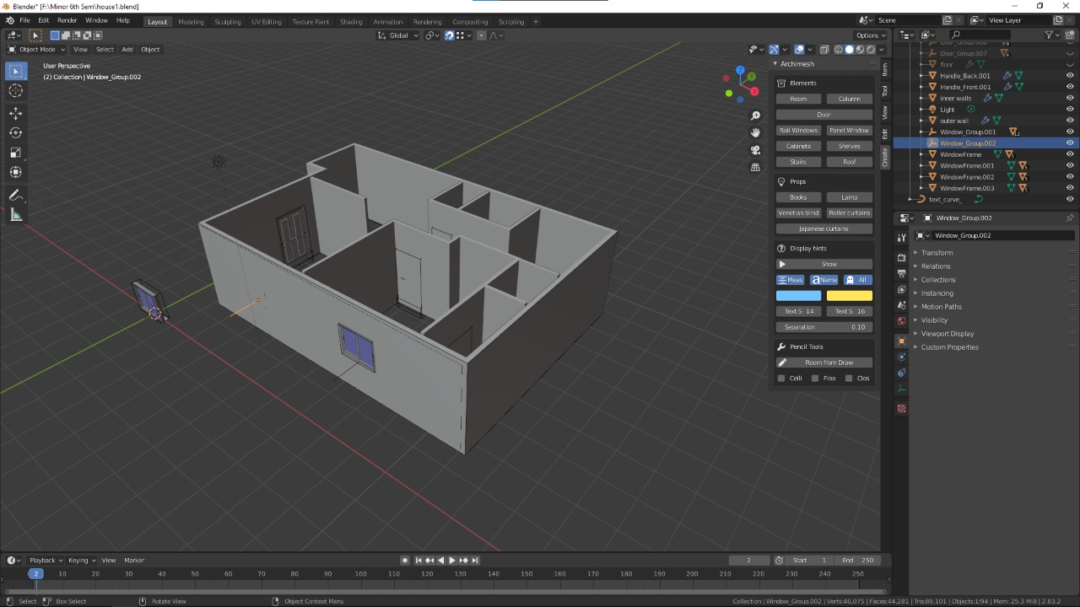
Blender
Fig 3. Side view of house model

Slide 15
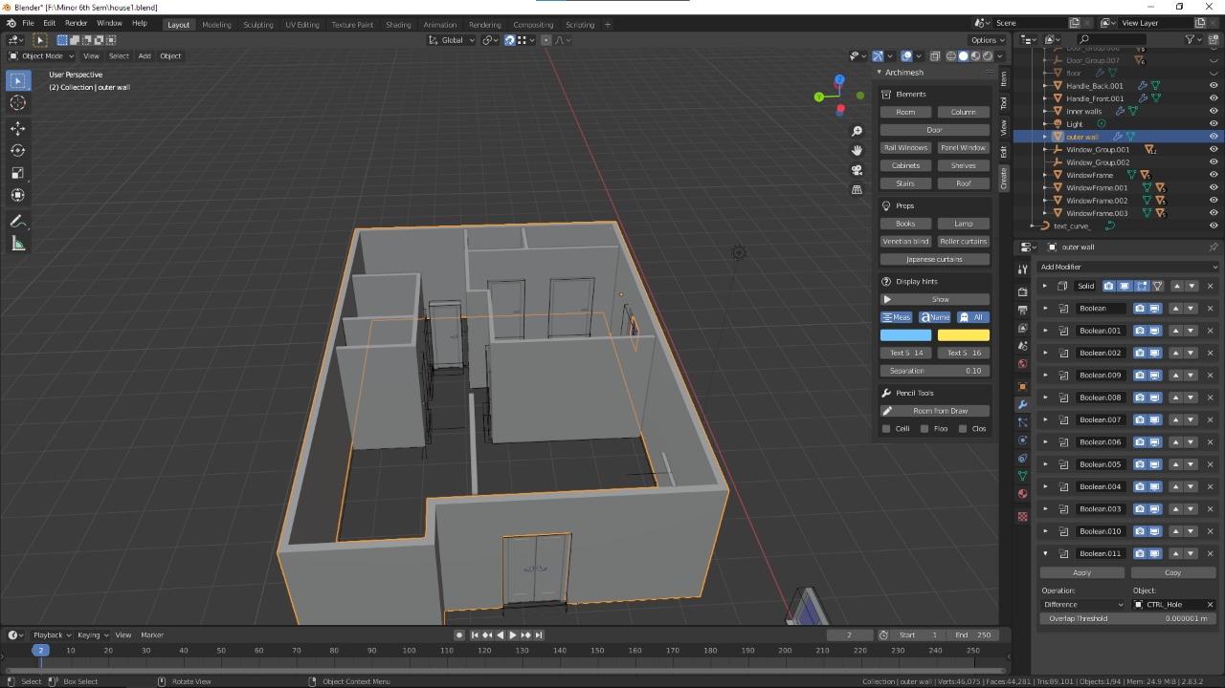
Fig 4. Side view of house model(contd.)

Slide 16
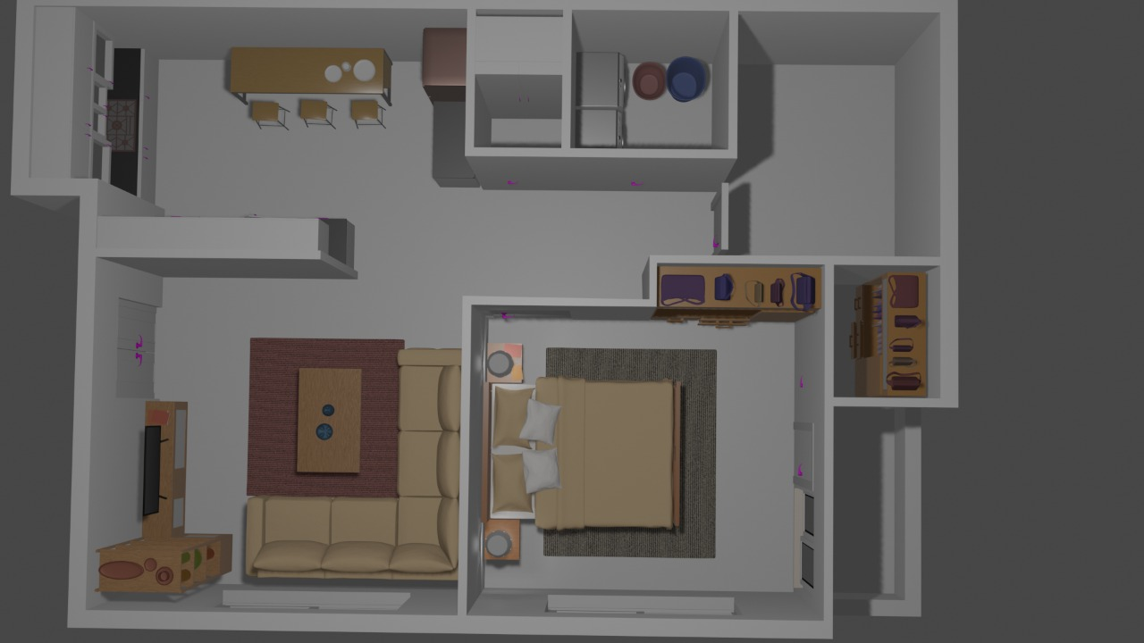
Fig 5. Top view of house model

Slide 17
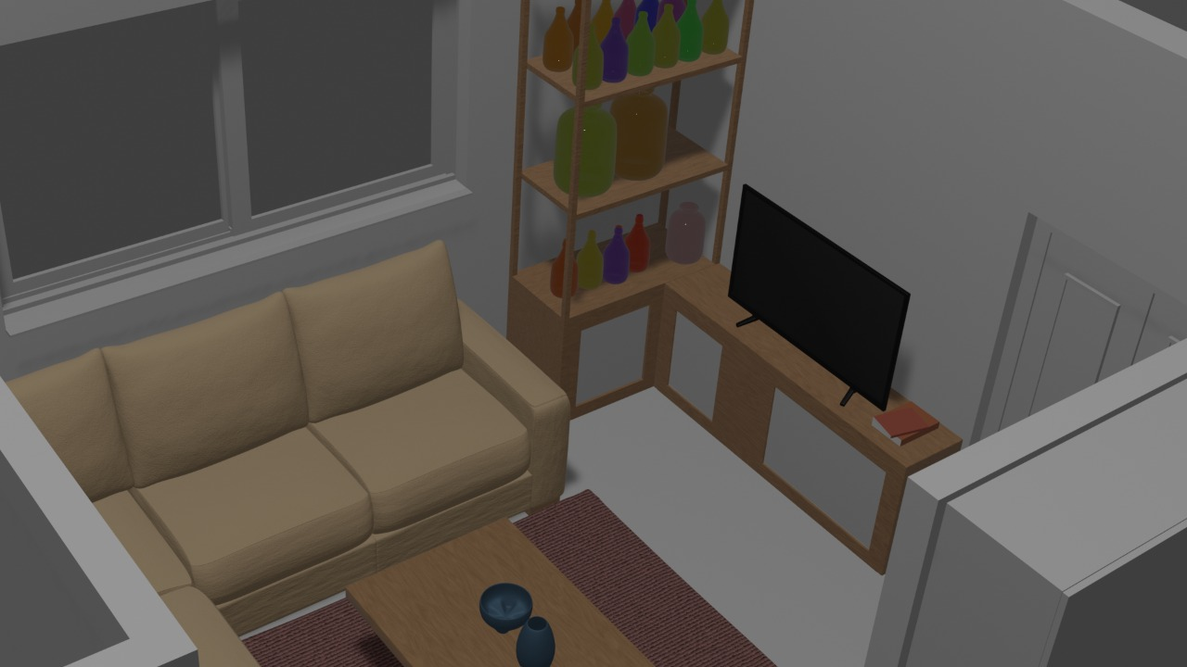
Fig 6. Top view with furniture placed

Slide 18
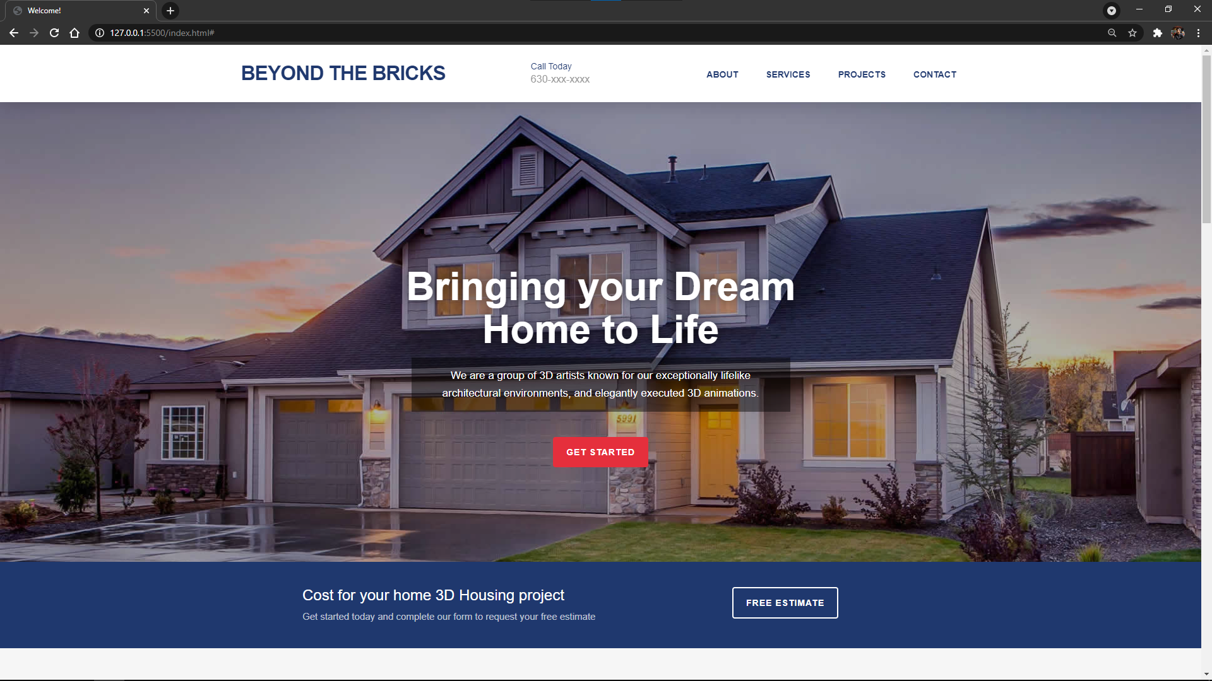
Website Snapshots
Fig 7. Homepage

Slide 19
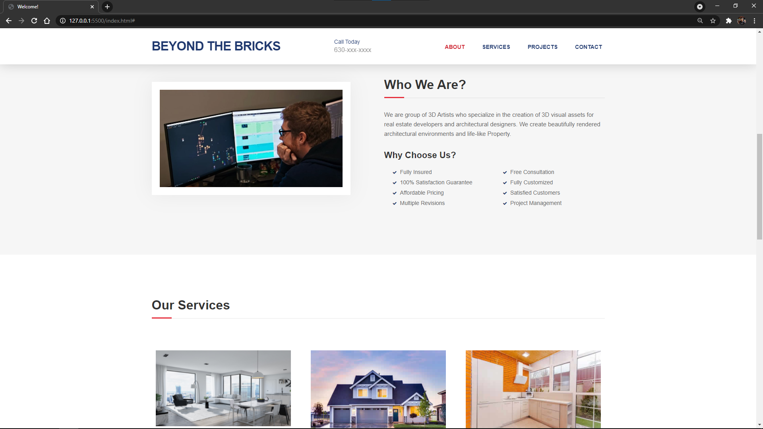
Fig 8. Homepage(cond.)

Slide 20
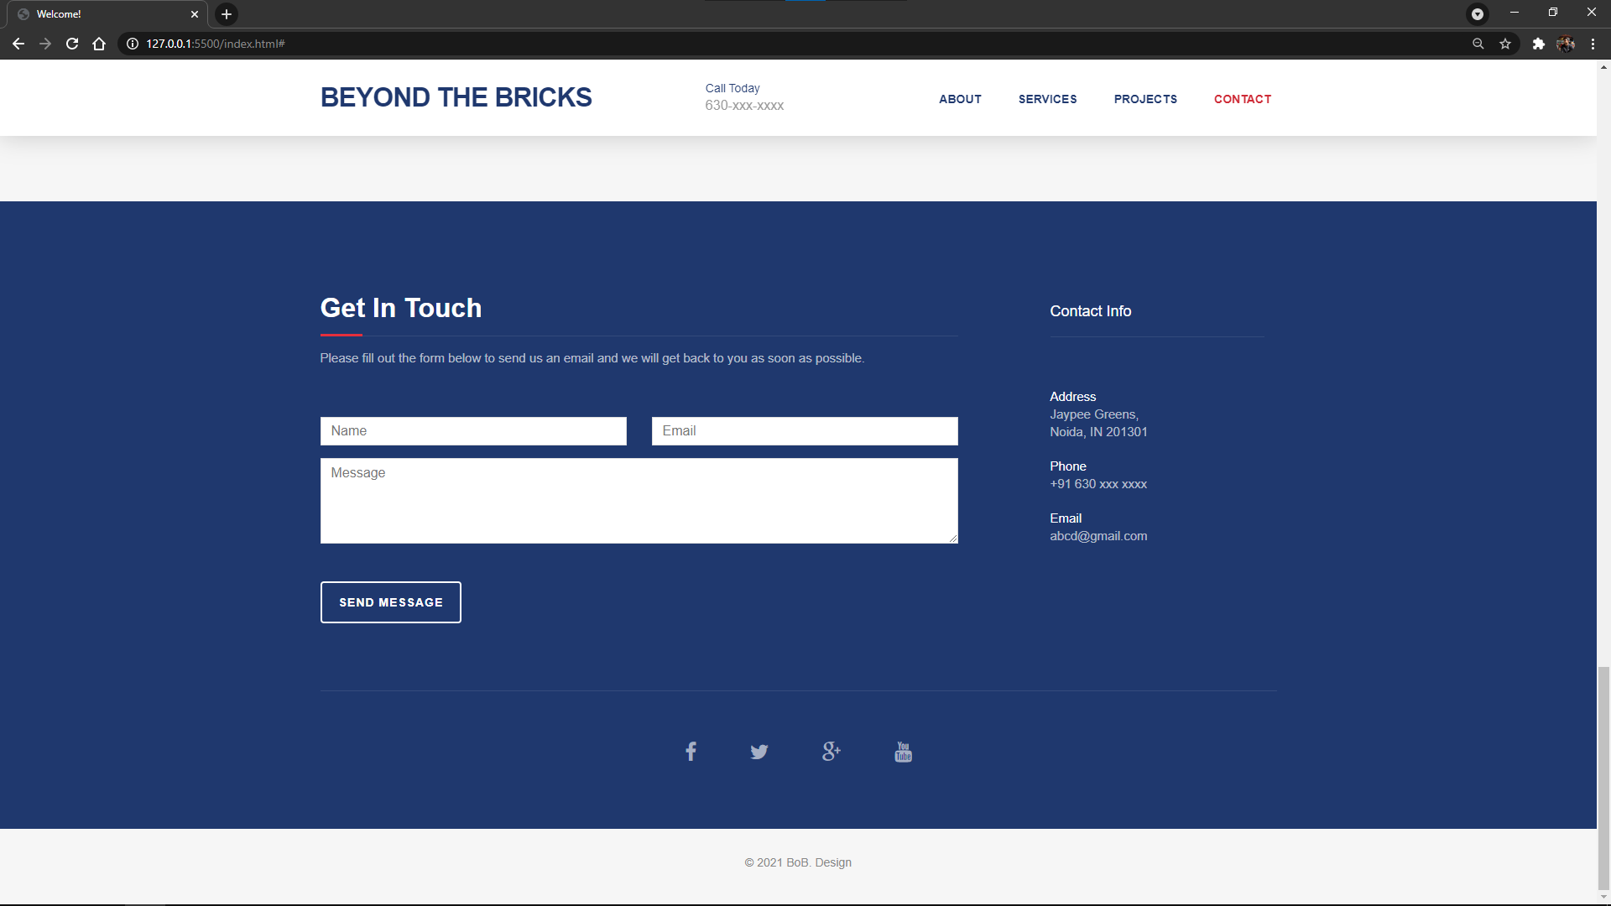
Fig 9. Homepage(contd.)

Slide 21
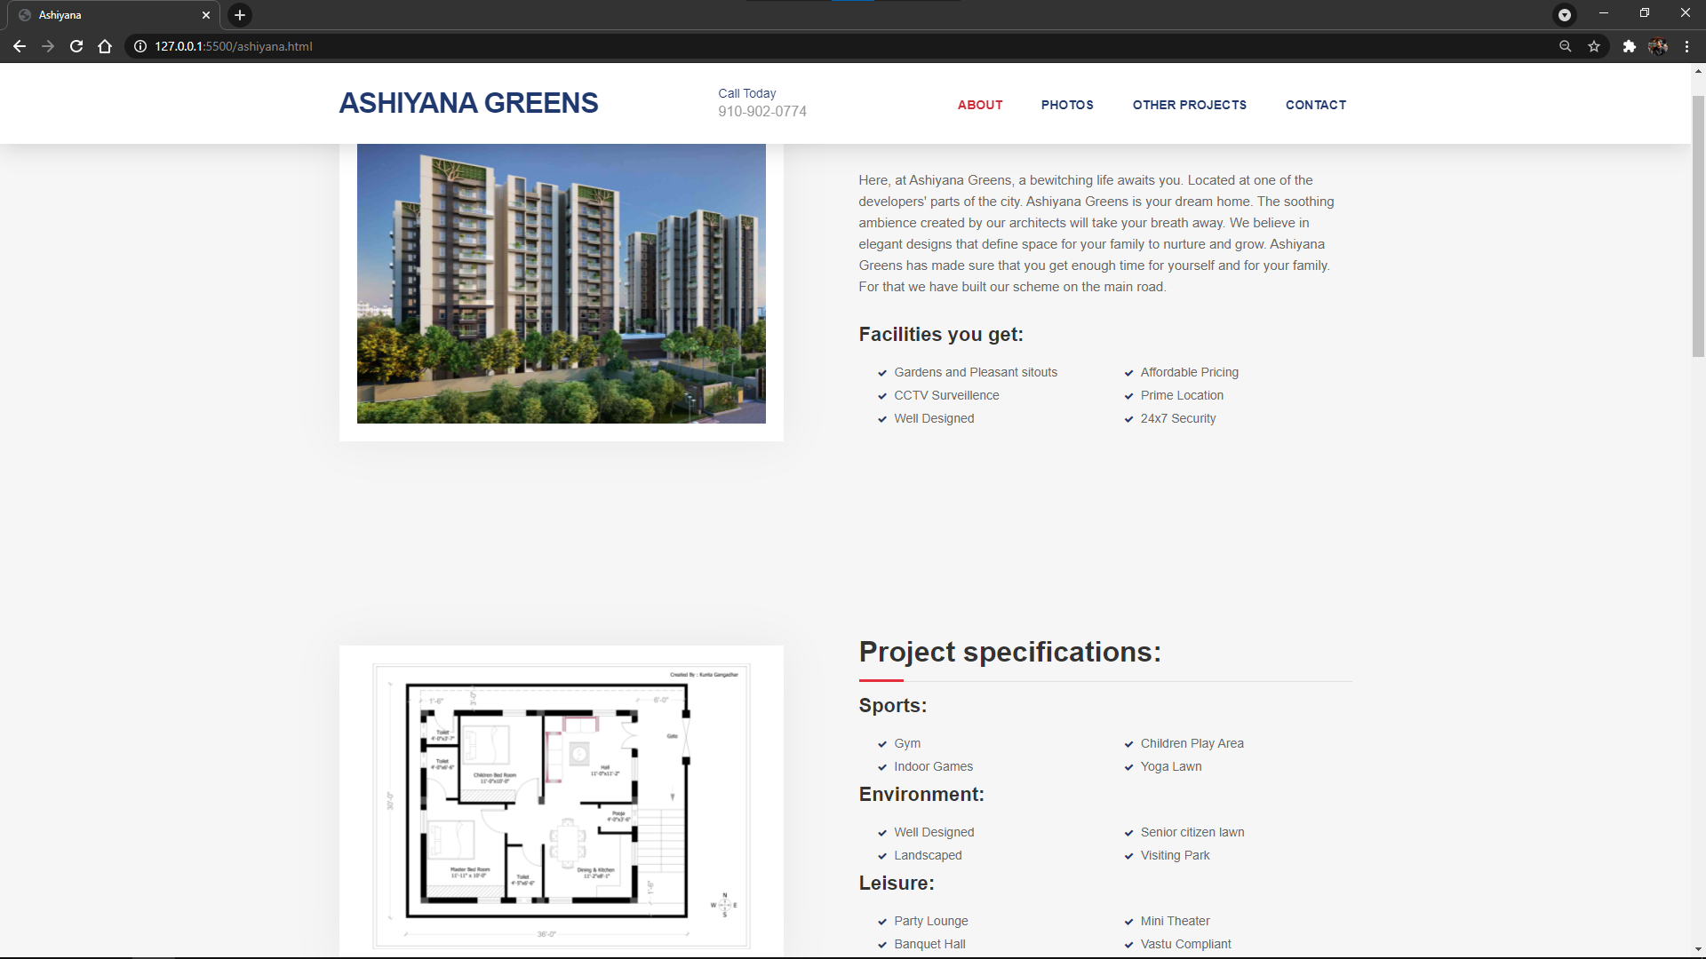
Fig 10. Demo Unit Webpage

Slide 22





Activity Flow
1
2
3
4
5
Log on to website
Select Residency Project
Take the 3D walkthrough
Contact Seller
directly from website
Have a look through our other projects

Slide 23

Advantages :
Buyers:
3D walkthrough allows a better understanding of the house as a virtual tour.
Provides close experience as an onsite visit is not required.
Sellers:
More people can invest in the seller’s project.
Can much easily show the project even before construction.

Slide 24
Future Scope
We intend to make UI/UX improvements to our website to make it more user friendly.
We intend to include a map feature.
We also intend to add a House Price/Rent calculator according to their needs of the users.
We can also add a sorting and filtering algorithm which will help us to provide accurate recommendations.
We intend to also use Machine Learning to provide recommendations and suggestions.

Slide 25
Refrences
ABS (Australian Bureau of Statistics), 2000, 8129.0 Business Use of Information Technology Australia, [on-line], http://www.abs.gov.au/ausstats/ABS%40.nsf/b06660592430724fca2568b5007b8619/ 9c7742890adec989ca2568a900139423! OpenDocument, accessed 15 May 2001.
Adam, S. and Deans, K. R., 2000, “On-line Business in Australia and New Zealand: Crossing a Chasm”, Ausweb2K Sixth Australian World Wide Web Conference, Southern Cross University, Lismore, [on-line], http://www.ausweb.scu.edu.au/aw2k/papers/adam/paper.html, Accessed 7 June 2001.
Benbasat, I., Goldstein, D. K. and Mead, M., 1987, "The Case Research Strategy in Studies of Information Systems", MIS Quarterly, vol 11, issue 3, pp 369-387, September.
Bode, S., and Burn, J., 1999, “SMEs and the Role of Consultants in Establishing e-business: A Case Analysis”, Proceedings of CollECTeR ‘99, Victoria University, New Zealand, [on-line], http://www.collecter.organisation/coll99/bode.pdf, accessed 17 March 2001.
Castleman, T. and Cavill, M., 2001, “e-Everything: e-Commerce, e-Government, e- Household, e-Democracy”, Proceedings of the 14th Bled Electronic Commerce Conference, Bled Slovenia, June 25-26, [on-line], http://mis.deakin.edu.au/research/Working_Papers-2001/2001_02_Castleman.pdf, accessed 27 June 2001.

Slide 26
Thank You!

